Slide 1
Geospatial Prediction – MCI Crime Locations
By: Mohamed Benaicha
Portfolio: https://github.com/mohbenaicha

Slide 2
Summary
Problem: the range of patrol zones is large and consumes PD resources, hence an approach that pinpoints hot crime locations is required
Hypothesis: while counting the number of crime incidence and mapping it according to a heat map may provide some help, it doesn’t pick up more subtle patterns such as temporal patterns. Linear or non-linear regression algorithms may work better, while crime occurrence is hypothesized to be very random.
Methodology: clean and impute data; engineer necessary time/space features, dimensionality reduction, training linear and non-linear regressors
Findings:
Non-linear regressors such as ensemble learners (i.e xgboost regression) get the highest accuracy in predicting a crime location but take much longer to train.
Inference speeds of linear/non-linear regressors are comparable
Crime incidence is very random in nature, so pinpoint accuracy isn’t possible, instead a candidate list of potential crime locations is relayed to patrol units every time interval – say every hour
Adding information from census data can help in ‘profiling’ neighbourhoods and streets, but gives rise to ethical concerns

Slide 3
Summary
Data/data collection: raw data set provided by the Toronto Police department called the Major Crimes Indicator (MCI)
Salient challenges/ recommendations for improvements:
Model size: ensemble learners provide an improvement over the simple yet fast linear regression
Improvements: training on cloud infrastructure such as SageMaker or custom elastic compute instances
Detailed features: the MCI dataset comes with a number of good features but lacks other important features such as profiles of those involved in the crime (likely due to ethical concerns)
Improvements: feature engineering such as what I’ve done in scraping data to help improve prediction accuracy by looking for the proximity of police stations, bars and parks which may have a negative or positive effect on a crime occurring at the particular location

Slide 4
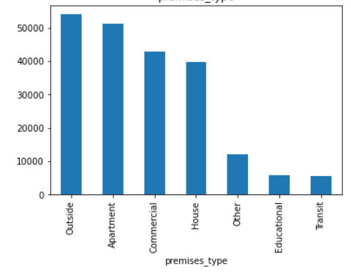
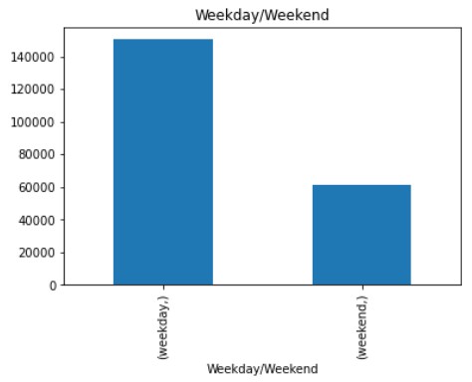
Data Exploration
An example of the classification of property on which the crime occurred
250K crime reports
Features: features related to: time/date of crime occurrence and time/date of crime report; location features such as the type of property and long/lat coordinates; nature of the crime;
No feature is uniformly distributed and quite a number exhibit significant skews as per the hypothesis
Engineered features helped reduce dimensionality in an already-complex problem (ex. instead of 7 weekday categories, have weekend and weekday categories)

Slide 5
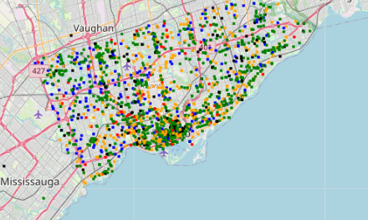
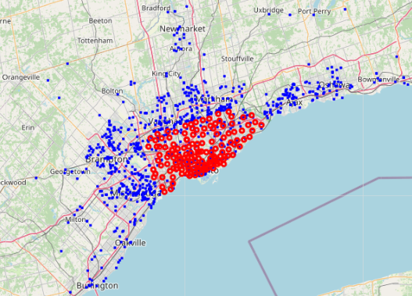
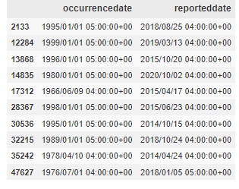
Data Exploration
No physical patterns are observable based on feature categories (ex. Colour coding crime type)
Most of the records with null values were discovered to be not within the operating jurisdiction of the TPS (indicated by the blue, where red are points that I’ve engineered as the center of neighbourhood clusters)
Other records with null values are reported within the past 8 years (when the MCI was being compiled) but as having occurred in the 80s and 90s and so were largely irrelevant

Slide 6
Feature engineering
Engineered features:
Created a weekend/weekday features from day of week features
Created a crime level feature from hourly crime occurrence feature
Created a season feature out of occurrence day of the year feature
Created a holiday feature out of occurrence day of the year feature
Added geospatial features including location of closest parks, bars and police stations from the crime occurrence location

Slide 7
Modelling
scikit learn’s PCA for dimensionality reduction
Cut out half the feature space for only a marginal (5%) loss in explained variance
scikit learn’s linear regression
Easily interpretable, fast training
Hard to learn non-linear features
XGBoost regressor
Ensemble learner with great accuracy
Uninterpretable, train time becomes cumbersome when paired with hyperparameter tuning (including tree hyper parameters, and the number of estimators)
Key takeaway: both models are quite accurate. Choice of which to deploy depends on infrastructure capacity

Slide 8
Pipeline
Training: data cleaning, feature transformation (engineered featured and PCA), training and evaluation
Inference: data validation, data cleaning, feature transformation (engineered featured and PCA), predictions

Slide 9
Challenges
Development:
Temporal element creates changing crime dynamics (the MCI spans 8 years of crime reports in Toronto)
Ethical issues of dealing with profile data
Hyper parameter choices are nearly infinite and have consequence on train time during cross validation
Production:
The model can only make predictions within neighbourhoods, so predictions are unique to each neighbourhood per the Toronto Police Service neighbourhood divisions
The model makes unique predictions of locations only as long as the input data is unique which depends on changing factors throughout the day such as the hour of the day.
To demonstrate the above: the model prediction will not change if the time of day has changed (such as from 10 AM to 11 AM) or the neighbourhood name has changed and these can either be automated to left as input at the discretion of the individuals operating the prediction system; put differently, running an inference on the same input features will yield the exact same location prediction since the model weights do not actively change and as long as inputs change, the model will predict unique locations.

Slide 10
Production package
Modules for training (ex: pipeline.py)
Modules for modelling tools and data processing utilities (ex: import_date.py)
Modules for package building/ publishing (ex setup.py, README.md)
Modules for validation and testing (ex: PyTest)
Modules for REST APIs (ex: app.py, api.py)
Saved model/weights object, fitted encoders object, string lookups objects, etc. (ex: joblib files)
CI/CD files (ex: I use CircleCI config files)
Config/ env variable/code dependency files (ex: model config, app config, api config, Docker, CircleCI, etc.)
Shell/bash scripts for various deployments steps (ex: bootstrapping for cloud-based deployment, EC2; Docker container building; Kubernetes services)

Slide 11
Source code
https://github.com/mohbenaicha/TPS-MCI-Location-Prediction

